Slide 1
On suicide Using Choice Theory to understand the behaviour that could end all suffering at once
Danko Butorac
Keynote: Dick Pulk training day, Dublin, May 2024

Slide 2
Topics
Suicide risk assessment
Defining the problem
Where do the ideas behind Choice Theory come from?
Creating yourself - a systemic theory
Biology of a small neuron

Slide 3
The client 22 y/o male – a Third mate sailing on a tanker. Living with his mother. After a 3-year love affair, his fiancee breaks up with him

Slide 4
Everything falls apart, weird thoughts go through my mind
Suicidal ideation means lower risk if present without a plan – need for suicide risk assessment
Hates him/herself
Ideas like: it would be better if I was gone,if I was never born
I'm just a burden to everyone
I think about the worst things
I think about the people who I’ll never see
If only I went to sleep and never woke up
If I were in an accident…

Slide 5
Highest risk: Suicide planning,taken action – making a suicide plan
Has written a will
Has acquired the means and knows where to find the particular gun,pills, rope, etc.)
Knows where and when he/she will do it
Knows to whom and how he/she wants to say goodbye (higher risk if already said goodbye)
Has covered all debt or knows how
Has finished all work, no pending tasks
After a period of depressing behaviour, now feels much better

Slide 6
Risk factors (the more factors present, the greater the risk)
Physical illness (2x higher risk) – cancer, aids, epilepsy, chronic pain
First three weeks after release from the hospital (after psychiatry treatment 100x greater)
Non-suicidal self-injury – skin burning, cutting, hitting –higher risk (adults at higher risk because 15% adolescent try self-harming behaviour)
Prior suicide attempt (if it required medical help– higher risk)
Suicide of a close person
Great personal loss (partner, job, family member, …)
Depressing (people who depress account for 75% total suicide)
Schizophrenia (10%)
Substance dependent behaviour

Slide 7
Risk factors
High risk behaviour – alpinism, fast driving, etc.
Men 3x higher risk than women (women older than 50, men 35-45 y/o highest risk). Only 10% of all suicide is for girls and boys 10 to 19 y/o, girls try, boys die.
In adolescence sexual orientation (non-hetero higher risk)
Loneliness, rage, abuse
Accessed online content that promotes suicide (e.g. Momo)
Inability for self-care or care for significant others
Financial, existential problems
Recent change of living condiions (moving to another town – country, higher risk)

Slide 8
Client cries: I know she’s cheating on me! She betrayed me. It’s time to end it all! (C voices his knowledge about behaviour of his fiancée. He is connecting it with “me” believing her behaviour can betray him)

Slide 9
Epistemology: where does knowledge come from? Stoics - Epictetus: It is not events that disturb us, but what we think about those events
I know

Slide 10
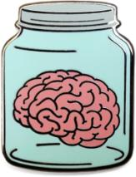
Descartes: Cogito ergo sum 17th century Huserl: we can know only of something that is within the grasp of our consciousness – phenomenology – 20th century
I know

Slide 11
Kant: dialectics
THESIS | ANTITHESIS
She is sending hearts to another man = she loves another, she is cheating | I plan to marry only someone who is monogamous and loves me exclusively

Slide 12
Do circumstances create me … or I create me? Who is the “I” that is creating “me”?
…on me…

Slide 13
Heidegger: Being human - Being here (dasein) - Being here and now (humanism) - Being here and now in the world - Being here, now in the world by relating

Slide 14
I, me and creating (systemic theory)
INSTRUCTIONS
BASIC NEEDS, QW
ABILITY TO TRACK AND COMPARE INFORMATION WITH INSTRUCTIONS
PERCEPTION EXPECTATION
ABILITY TO HARMONISE
ORGANISED BEHAVIOUR AND CREATIVITY

Slide 15
Cybernetics
Ross Ashby – living beings and machines are not material or anatomy, but what they do

Slide 16
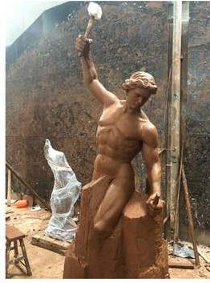
Heinz Von Foerster (paraphrase)
In order to make theories about organisms, I need to have an organism

Slide 17
Francisco Varela – Embodied cognition
Each behaviour (thinking too) is a bodily function
All perception is in the body
Every object is an opportunity to act

Slide 18
What is the problem really?
Depressing
Begging you to stay
Doing cocaine
Drinking
Wating to kill myself
Crying
Living without you

Slide 19
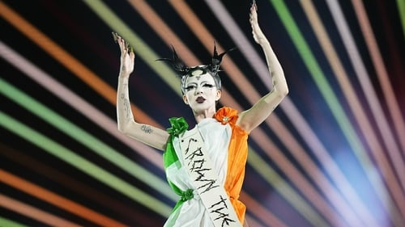
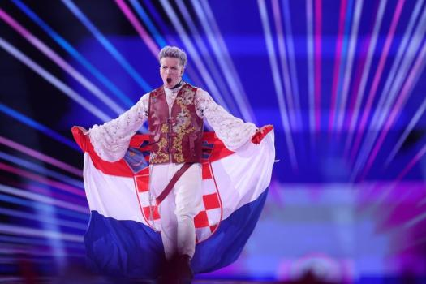
Eurovision 2024

Slide 20
Loreen – Euphoria
Why, why can't this moment last forevermore?
Tonight, tonight eternity's an open door
No, don't ever stop doing the things you do
Don't go, in every breath I take I'm breathing you
Euphoria
Forever, 'til the end of time
From now on, only you and I
We're going u-u-u-u-u-u-up
Euphoria
An everlasting piece of art
A beating love within my heart
We're going u-u-u-u-u-u-up
Winner Eurovision Song Contest 2012

Slide 21
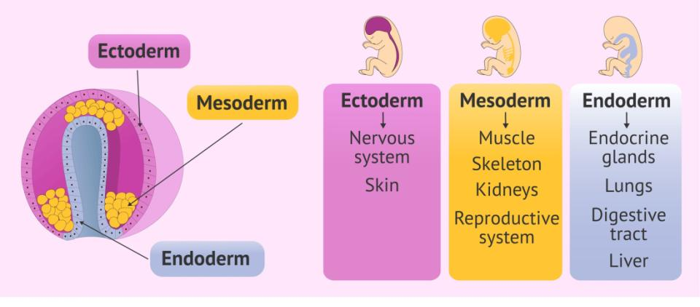
Brain = Skin

Slide 22
Cell membrane receptors

Slide 23
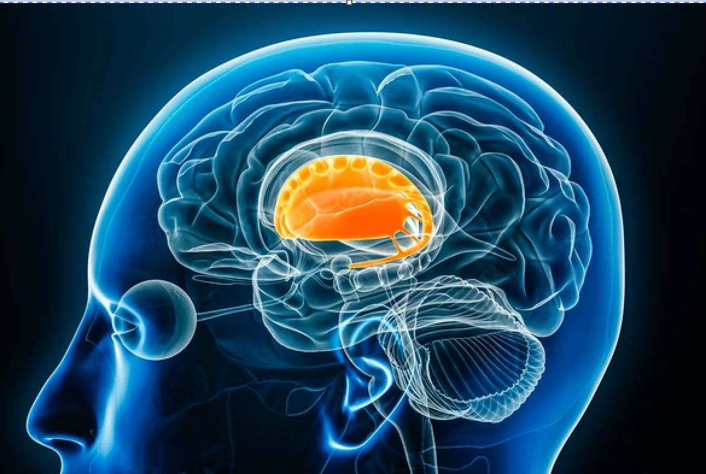
Striatum

Slide 24
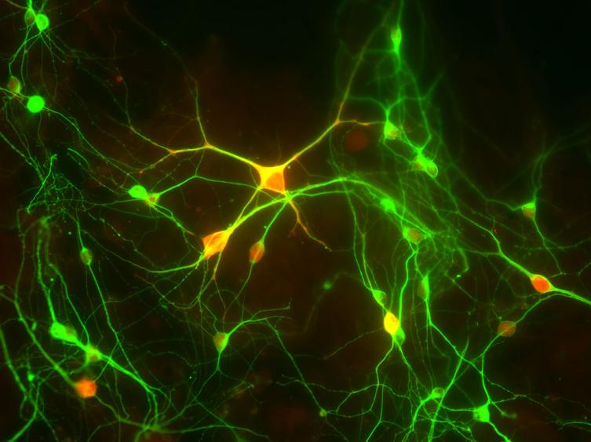
Neurons in the Striatum

Slide 25
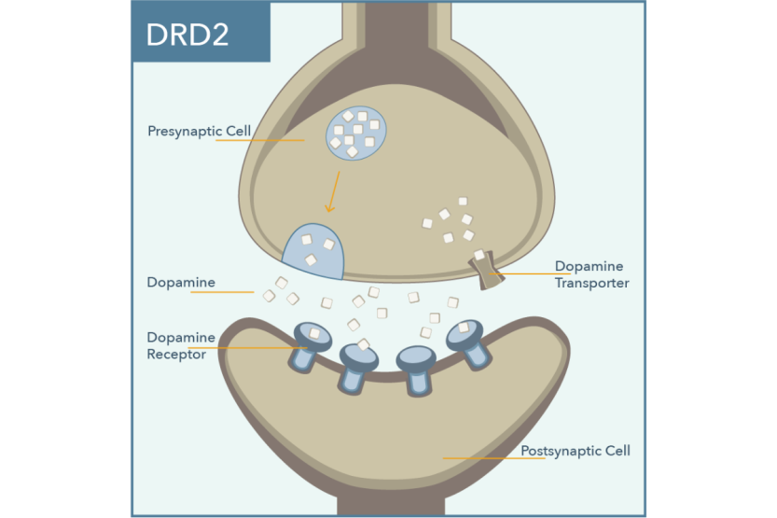
Synapse
Presynaptic
neuron
Synaptic cleft
Postsynaptic
neuron

Slide 26
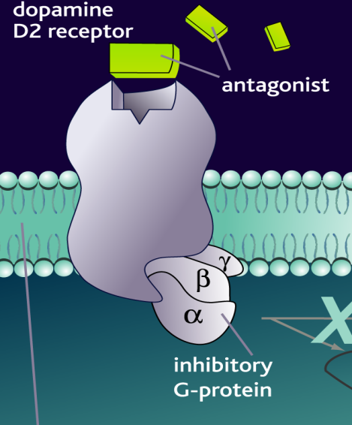
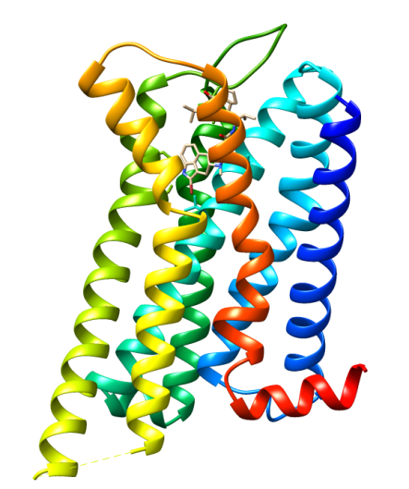
Cell membrane Dopamine D2 receptor

Slide 27
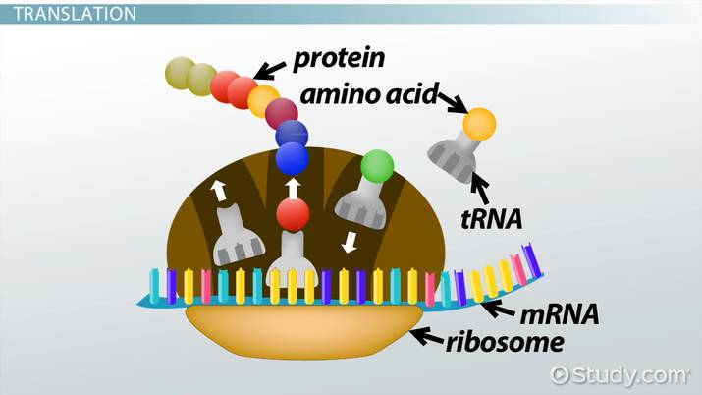
Protein synthesis (creating)

Slide 28
Protein synthesis (creating life!)

Slide 29
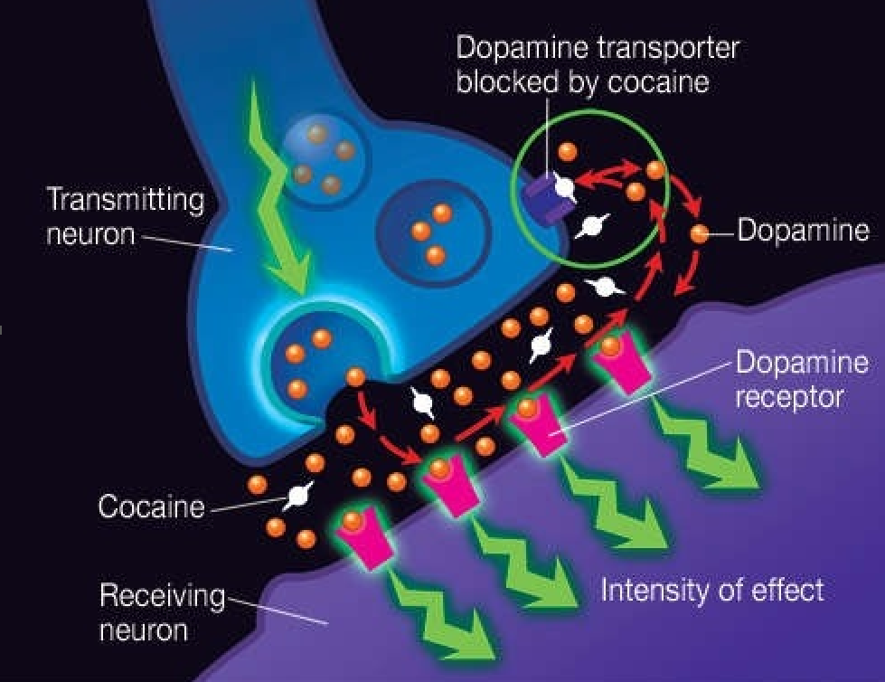
Cocaine blocks dopamine transport

Slide 30
Number of receptors reduce - tolerance (anhedonia)

Slide 31
Common advice
Have you tried talking to her?
Send her a message
Don’t be sad
Time heals all wounds
Here, have some chocolate

Slide 32
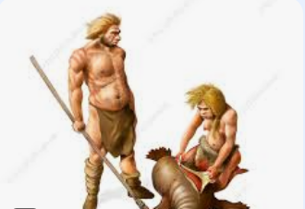
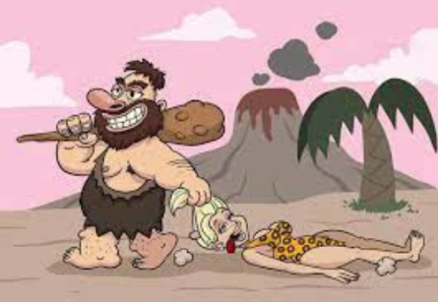
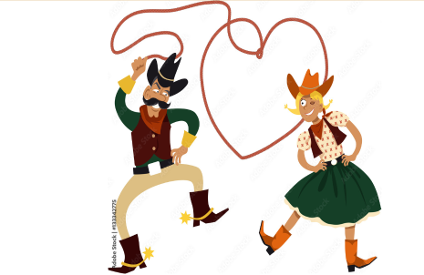
Other solutions known to men to deal with the same problem
In order to reach EUPHORIA

Slide 33
C: She is chearing on me!
I was cheating myself…
…by believing she will be sending hearts and kissing to me exclusivelly. But I realised she is sending hearts and kissing another

Slide 34
The problem is not that I have to live without you from now on
The problem is that I insist (urge and demand) that I remain your partner

Slide 35
Purpose of insisting?
To do something!
To be a something!

Slide 36
I don’t see a woman What I see is an opportunity to act But she sees something in me too
Why did I need her to kiss me?
Because I thought that is the only way for me to be a partner!

Slide 37
Choice Theory Beliefs
My behaviour is my choice in any given circmstance
Ergo – she can’t make me behave in any way
I’m the one producing my misery
I’m the one who is focusing on being a partner only by being with her
I am the one in charge of creating my own partnership
Now I’m creating it in a very painful way

Slide 38
Takeaway?
Talk to clients about their beliefs
Talk to clients about the purpose of their behaviour
Most clients demand or insist something of themselves which is not possible
They think the “not possible” part is the problem, but we know demanding is the problem

Slide 39
Reference
D R Wallace 1, C F Mactutus, R M Booze (1996): Repeated intravenous cocaine administration: locomotor activity and dopamine D2/D3 receptors, Synapse, Jul;23(3):152
NIDA (2024): Cocaine Research Report: How does cocaine produce its effects? https://nida.nih.gov/publications/research-reports/cocaine/how-does-cocaine-produce-its-effects
Aguinaga D, Medrano M, Vega-Quiroga I, Gysling K, Canela EI, Navarro G and Franco R (2018) Cocaine Effects on Dopaminergic Transmission Depend on a Balance between Sigma-1 and Sigma-2 Receptor Expression. Front. Mol. Neurosci. 11:17.
Brian C. Clark, Niladri K. Mahato, Masato Nakazawa, Timothy D. Law, James S. Thomas (2014): The power of the mind: the cortex as a critical determinant of muscle strength/weakness; Journal of Neurophysiolog

Slide 40
Reference
Collins, S. H., Wisse, M., Ruina, A. (2001) A three-dimensional passive-dynamic walking robot with two legs and knees. Int. J. Robotics Research, 20:607-615.
Giada Lettieri et al. (2024):Dissecting abstract, modality-specific and experience-dependent coding of affect in the human brain.Sci. Adv.10.
Raji, Cyrus A. et al. ‘Exercise-Related Physical Activity Relates to Brain Volumes in 10,125 Individuals’. 1 Jan. 2024 : 829 – 839.
Strack, Fritz; Martin, Leonard L.; Stepper, Sabine (May 1988). "Inhibiting and Facilitating Conditions of the Human Smile: A Nonobtrusive Test of the Facial Feedback Hypothesis". Journal of Personality and Social Psychology. 54 (5): 768–777

Slide 41
Reference
Schnall, S., Harber, K. D., Stefanucci, J. & Proffitt, D. R. (2008). Social support and the perception of geographical slant. Journal of Experimental Social Psychology, 44, 1246-1255
Schnall, S., Zadra, J. R., & Proffitt, D. R. (2010). Direct Evidence for the Economy of Action: Glucose and the Perception of Geographical Slant. Perception, 39(4), 464-482
Carney D.R., Cuddy, A. J. C., Yap, A. J. (2010). Power Posing: Brief Nonverbal Displays Affect Neuroendocrine Levels and Risk Tolerance. Psychological Science, 21, 1363-1368.

